Slide 1

CRICKOMANIA
The integrated cricket app
Group Members
2. Abhinav G S
18. Aravindsagar P A
66. Vishnu P

Slide 2


Products considered
Cricbuzz
Features news, articles and live coverage of cricket matches
Available in all platforms (Android, IOS ,Website....)
Most popular mobile app for cricket news and scores in India.

Slide 3


Products considered
Dream11
Platform that allows users to play fantasy cricket
Can create a virtual team of real-life players and earn points based on real matches
Those who score maximum points in the contest attains the first rank
Offers both free and paid contests

Slide 4

Products considered
Hotstar
Streaming service owned by Star India
Top video streaming app in the country
Includes access to sports content including the IPL, Cricket World Cups, Premier Leagues etc.

Slide 5
IDENTIFIED COMMON FEATURES ( FROM PRODUCT ANALYSIS )
Live score, match updates
Relevant notifications for upcoming events
Special content for major tournaments
Highlights of games
Checking for seat availability
Stats & news
Player profiles frequently updated
Scores of multiple simultaneously running games
Quick access from widgets
Fantasy cricket league
Users can give their comments during the game
Live streaming of sports
Short delay between real time match and scorecards
Provides fixtures for upcoming matches

Slide 6
FEATURES and suggestions collected FROM reviews
Not showing live commentary
live chat option
Not optimized for battery usage
Too many ads
Precise notifications
Auto refresh problem
No women's cricket records, stats etc.
Easy payment options
Point system error
Wrong player update
Refund problem
Can set remainders for contests
Highlights are available
Quality controls are possible
Errors while playing in smart TV
Full screen (landscape mode) is not actually full screen
Most features are paid

Slide 7
Features collected from survey
Live voice commentatory
Highlights
Stats & News
Video quality control
Precise notifications
Fantasy league
Pin to screen
Player profiles
Video download option
Dark mode
Lite version
Brightness control
Playback speed control

Slide 8
Ui/ux

Slide 9
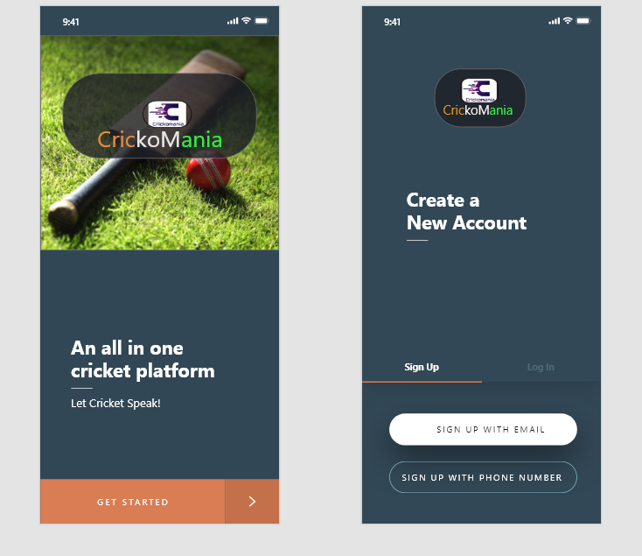
LOGIN

Slide 10
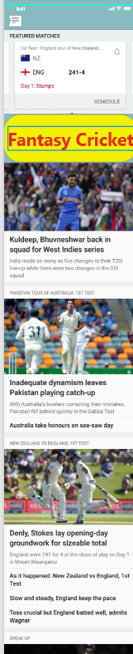
HOME

Slide 11
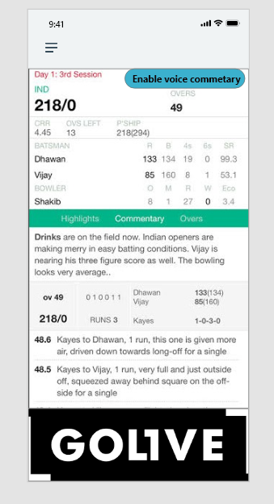
SCORECARD

Slide 12
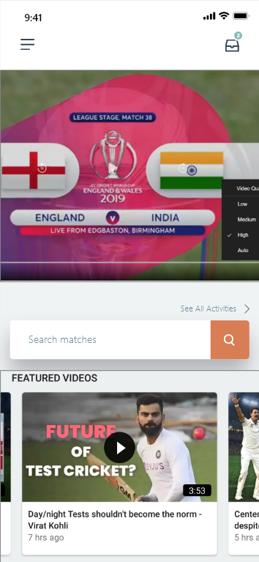
STREAMING PAGE

Slide 13
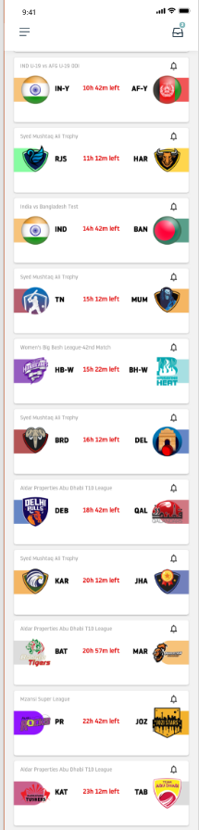
FANTASY LEAGUE

Slide 14
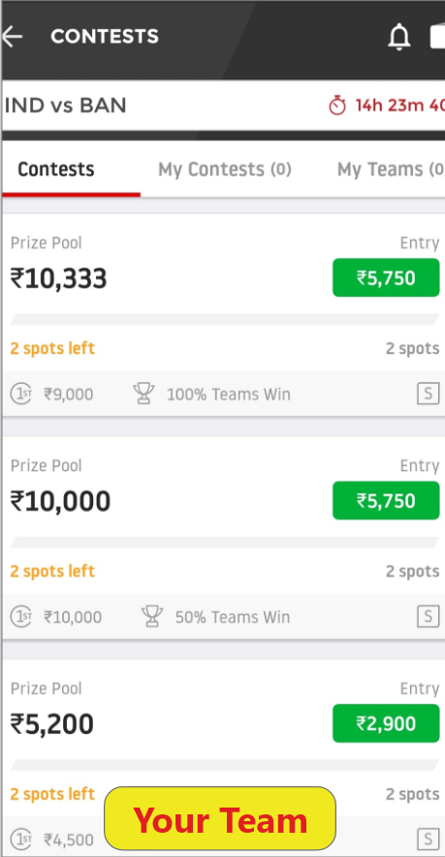
PRICE LAYOUT

Slide 15
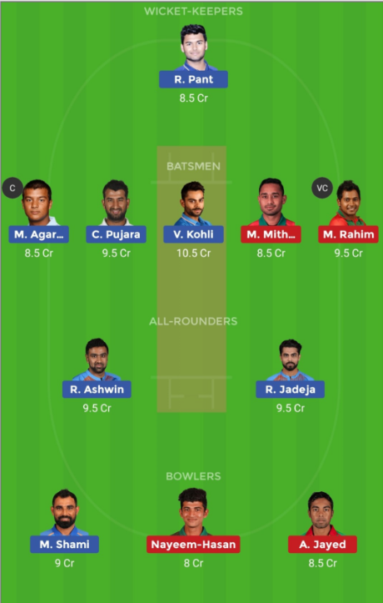
CUSTOMIZE TEAM

Slide 16
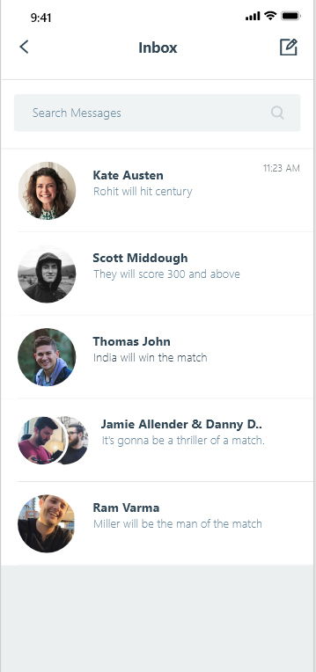
GLOBAL CHAT

Slide 17
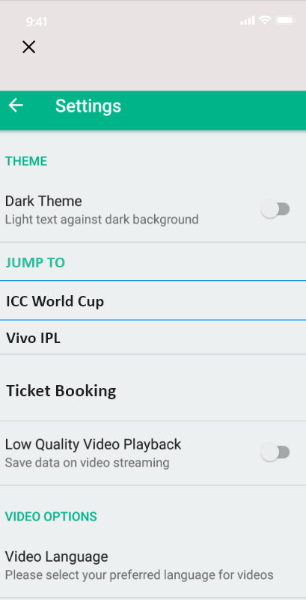
SETTINGS

Slide 18
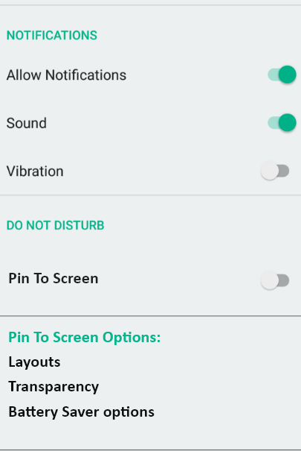
SETTINGS

Slide 19
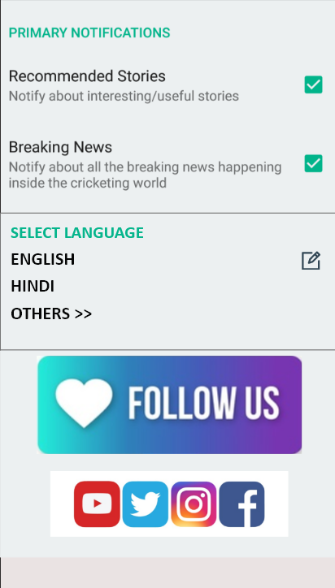
SETTINGS

Slide 20
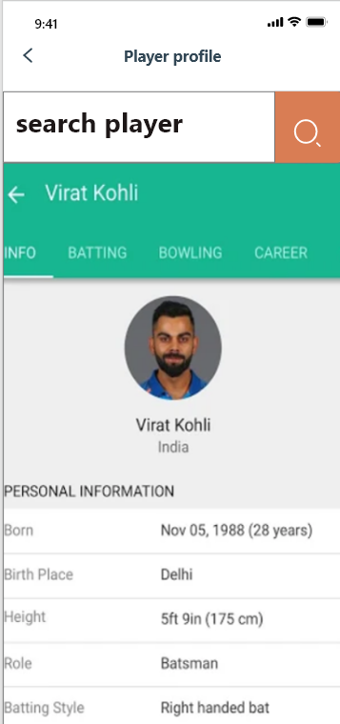
PLAYER PROFILE

Slide 21
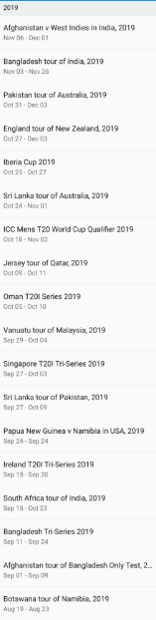
ARCHIVES

Slide 22
Thankyou...

